Slide 1
Software Engineering UML Continued
CS 1530
SUMMER 2020
Instructor: Sohel Sarwar
University of Pittsburgh
Lecture 6

Slide 2





Diagrams in the UML
Class diagram
Object diagram
Use case diagram
Sequence diagram
Statechart diagram
Activity diagram
Component diagram
Deployment diagram

Slide 3

Sequence Diagrams
AUML Sequence Diagram is an interaction diagram that details how operations are carried out. It captures the interactions between objects in the context of a collaboration.
Sequence Diagrams are time focus and they show the order of the interaction visually by using the vertical axis of the diagram to represent time what messages are sent and when. sequence diagram is an interaction diagram that emphasizes the time-ordering of messages;
https://www.visual-paradigm.com/guide/uml-unified-modeling-language/what-is-sequence-diagram/

Slide 4
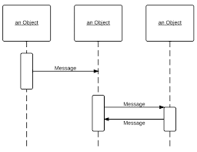
Sequence Diagram

Slide 5
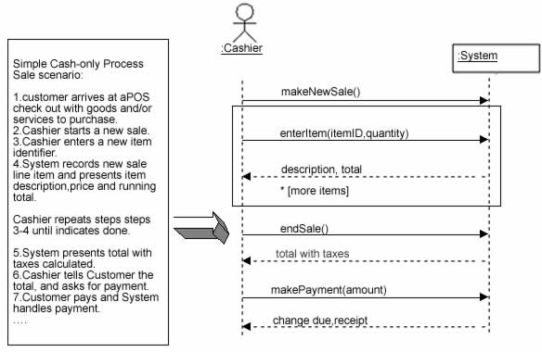
Sequence Diagram
Sequence Diagrams captures:
The interaction that takes place in a collaboration that either realizes a use case or an operation (instance diagrams or generic diagrams)
https://www.visual-paradigm.com/guide/uml-unified-modeling-language/what-is-sequence-diagram/

Slide 6
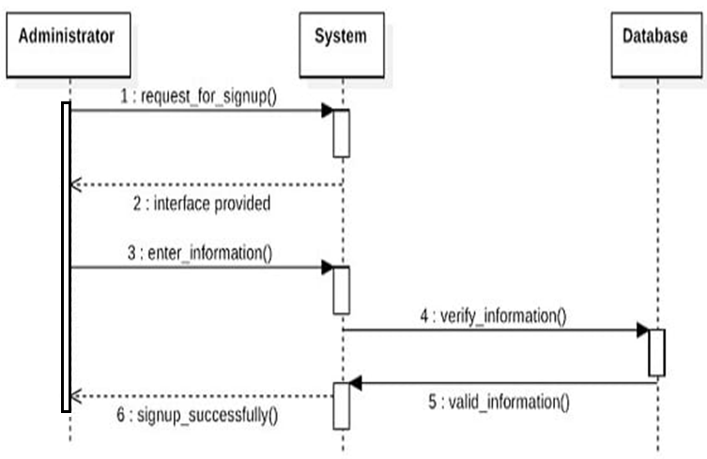
Sequence Diagram
Sequence Diagrams captures:
High-level interactions between user of the system and the system, between the system and other systems, or between subsystems (sometimes known as system sequence diagrams)
https://www.visual-paradigm.com/guide/uml-unified-modeling-language/what-is-sequence-diagram/

Slide 7
Sequence Diagrams
Sequence Diagram Dimensions:
Object Dimension
The horizontal axis shows the elements that are involved in the interaction
Conventionally, the objects involved in the operation are listed from left to right according to when they take part in the message sequence. However, the elements on the horizontal axis may appear in any order
Time Dimension
The vertical axis represents time proceedings (or progressing) down the page.
https://www.visual-paradigm.com/guide/uml-unified-modeling-language/what-is-sequence-diagram/

Slide 8
Sequence Diagram
X-Axis (objects)
member: LibraryMember
book:Book
:Book Copy
borrow(book)
Object
Life Line
Y-Axis (time)
ok = mayBorrow()
message
Activation box
[ok] borrow(member)
setTaken(member)
condition

Slide 9
Sequence Diagrams
Lifeline
A lifeline represents an individual participant in the Interaction.
Activations
A thin rectangle on a lifeline) represents the period during which an element is performing an operation.
The top and the bottom of the of the rectangle are aligned with the initiation and the completion time respectively
Call Message
A message defines a particular communication between Lifelines of an Interaction.
Call message is a kind of message that represents an invocation of operation of target lifeline.
Return Message
A message defines a particular communication between Lifelines of an Interaction.
Return message is a kind of message that represents the pass of information back to the caller of a corresponded former message.
https://www.visual-paradigm.com/guide/uml-unified-modeling-language/what-is-sequence-diagram/

Slide 10
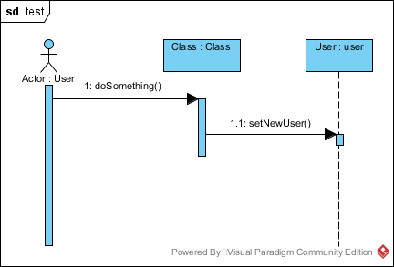
Sequence Diagram

Slide 11
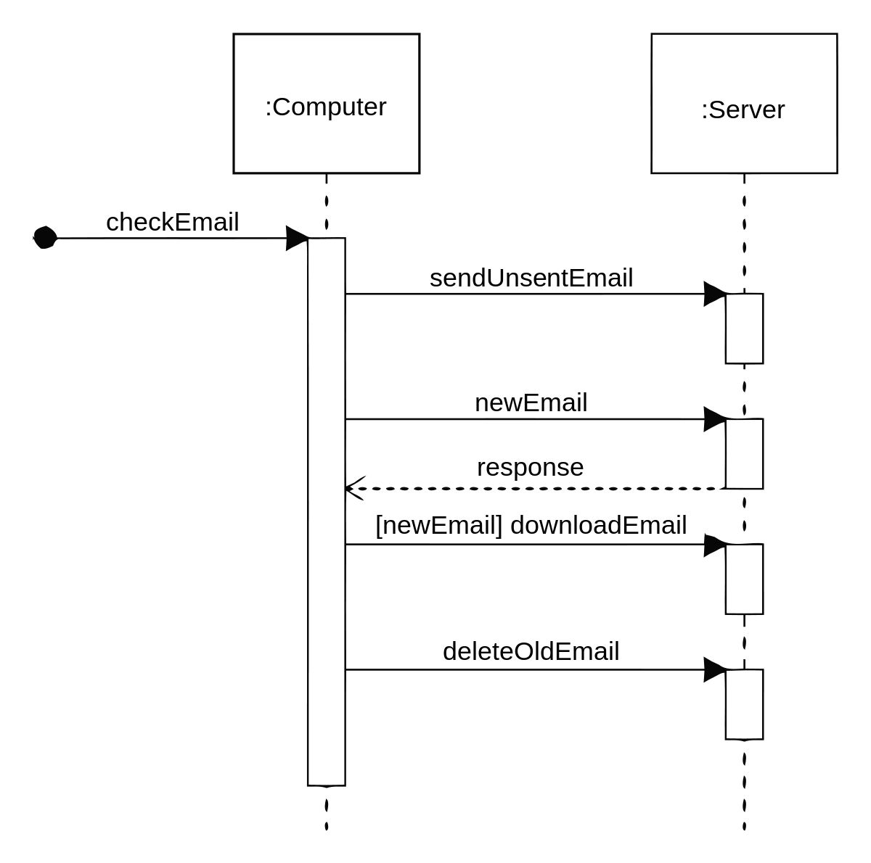
Sequence Diagram

Slide 12
Sequence Diagram
member: LibraryMember
book:Book
:Book Copy
borrow(book)
ok = mayBorrow()
[ok] borrow(member)
setTaken(member)

Slide 13
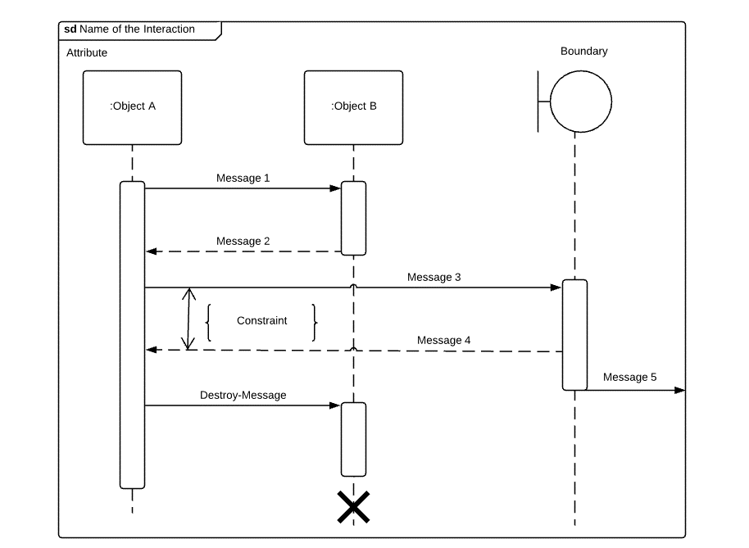
Sequence Diagram

Slide 14
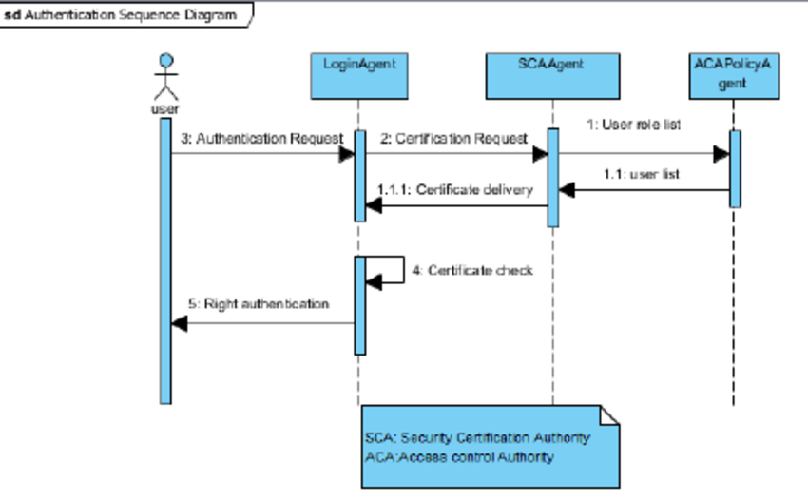
Sequence Diagram

Slide 15
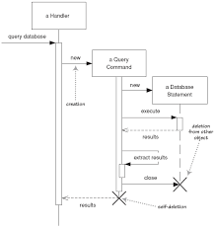
Sequence Diagram

Slide 16
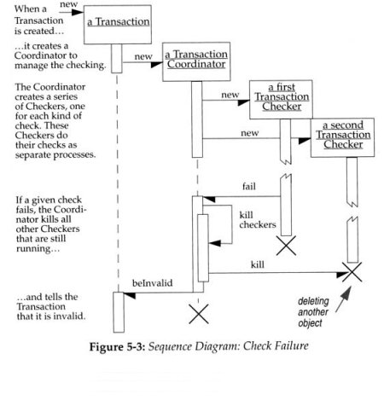
Sequence Diagram

Slide 17
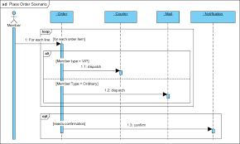
Sequence Diagram

Slide 18

Statechart diagrams
A statechart diagram shows a state machine, consisting of states, transitions, events, and activities. Statechart diagrams address the dynamic view of a system. They are especially important in modeling the behavior of an interface, class, or collaboration and emphasize the event-ordered behavior of an object, which is especially useful in modeling reactive systems.

Slide 19
Elements of State Diagrams
The basic elements of state diagrams are
states – the state in which the object finds itself at any moment
transitions – take the object from one state to another
events – cause the transition from one state to another
actions – take place as a result of a transition
In the UML, many other extensions have been added, such as:
generalization/Inheritance among events (i.e. a mouse click and keyboard input as subclasses of user interface events)
hierarchical diagrams for managing complexity (from StateCharts)
guards – conditions on transitions
State Diagrams should only be used for objects with significant dynamic behavior
State
Diagram

Slide 20
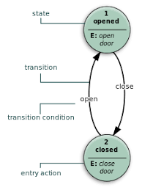
State Diagram

Slide 21
Elements of State Diagrams: Events
ChangeEvent (i.e.: when(x>y))
A change event models an event that occurs when an explicit boolean expression becomes true as a result of a change in value of one or more attributes or associations.
A change event is raised implicitly and is not the result of some explicit change event action.
CallEvent (i.e.: conflictsWith(Appointment))
A call event represents the reception of a request to synchronously invoke a specific operation.
Note that a call event instance is distinct from the call action that caused it.
State
Diagram

Slide 22
Elements of State Diagrams: Events
SignalEvent (i.e.: leftButtonDown)
A signal event represents the reception of a particular (asynchronous) signal.
TimeEvent (i.e.: after(1 second))
A TimeEvent models the expiration of a specific deadline. Note that the time of occurrence of a time event instance (i.e., the expiration of the deadline) is the same as the time of its reception.
State
Diagram

Slide 23
State Diagram
Basic UML State Diagram Syntax
A state is drawn with a round box, with three compartments for
name
state variables (if any)
actions to be performed
A transition is drawn with an arrow, possibly labeled with
event causing the transaction
guard condition
Action to perform

Slide 24
State Diagram
State Diagram: Predefined Action Labels
“entry/”
identifies an action, specified by the corresponding action expression, which is performed upon entry to the state (entry action)
“exit/”
identifies an action, specified by the corresponding action expression, that is performed upon exit from the state (exit action)
“do/”
identifies an ongoing activity (“do activity”) that is performed as long as the modeled element is in the state or until the computation specified by the action expression is completed (the latter may result in a completion event being generated).
“include/”
is used to identify a submachine invocation. The action expression contains the name of the submachine that is to be invoked.

Slide 25
State Diagram
State Diagram: State Variable
We can explore the phenomenon of rapid state diagram growth by examining a typical class with three attributes
Each combination of values of the attributes of this class constitute a different state for the class
Note that the attributes are effectively independent of each other
any combination is valid

Slide 26
State Diagram
State Diagram: Combinatorial Explosion
The number of states and the number of transitions grows very quickly as you model complex state machines (→ combinatorial explosion)
This is the Achilles Heel of finite state machines
It has prevented the widespread use of state machines in the past

Slide 27
State Diagram
Simple Heart Monitor System State Diagram

Slide 28
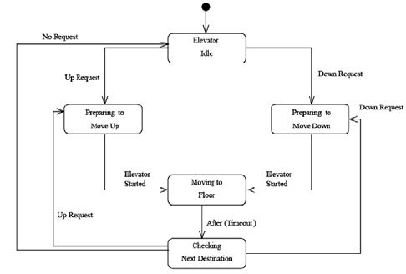
State Diagram
Elevator State Diagram

Slide 29
State Diagram
Seminar Registration State Diagram

Slide 30
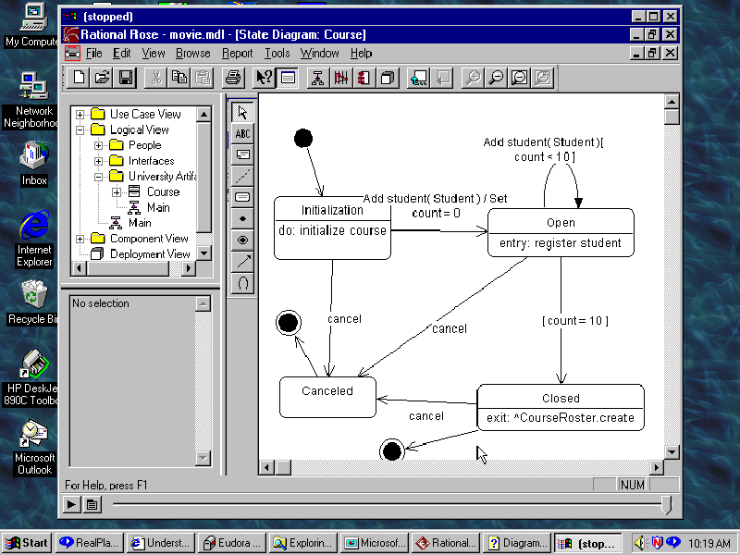
State Diagram
Course Registration State Diagram

Slide 31
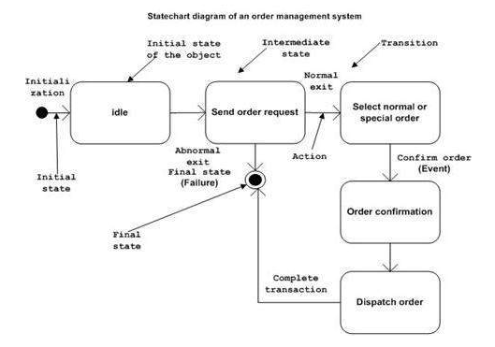
State Diagram

Slide 32

Activity diagram
An activity diagram is a special kind of a statechart diagram that shows the flow from activity to activity within a system. Activity diagrams address the dynamic view of a system. They are especially important in modeling the function of a system and emphasize the flow of control among objects.

Slide 33
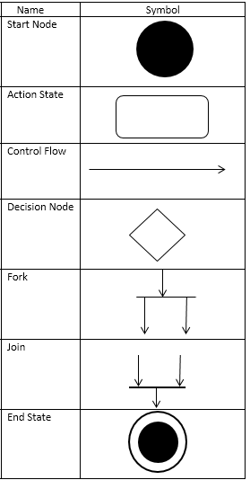
Activity Diagram

Slide 34
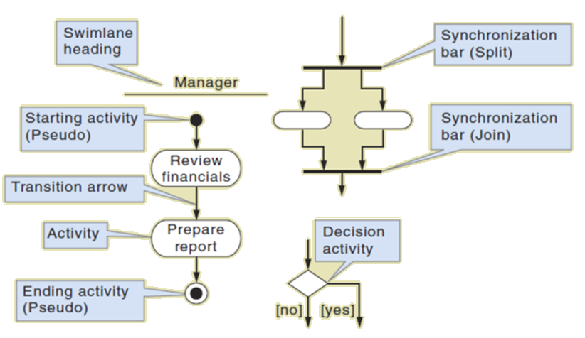
Activity Diagram

Slide 35
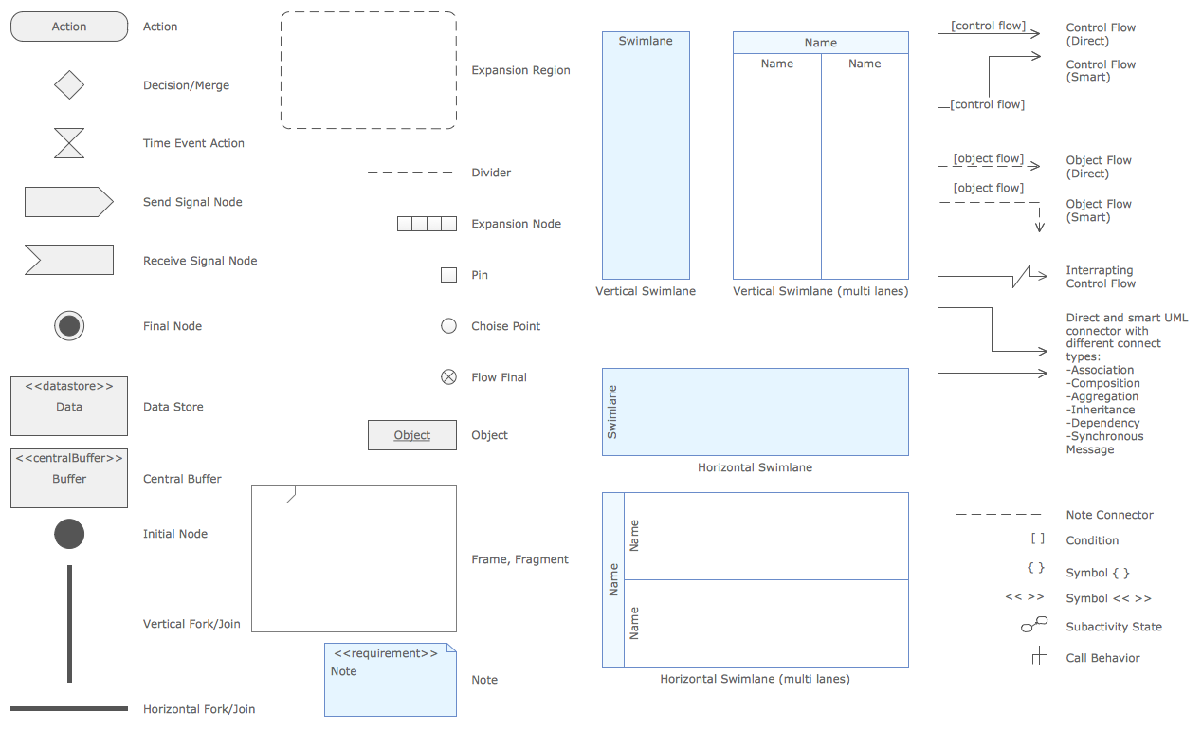
Activity Diagram

Slide 36
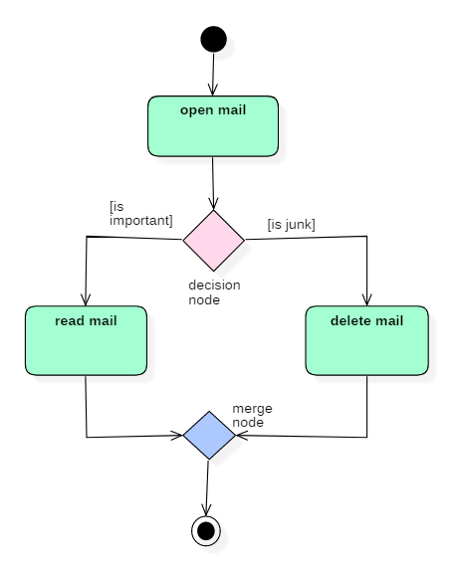
Activity Diagram

Slide 37
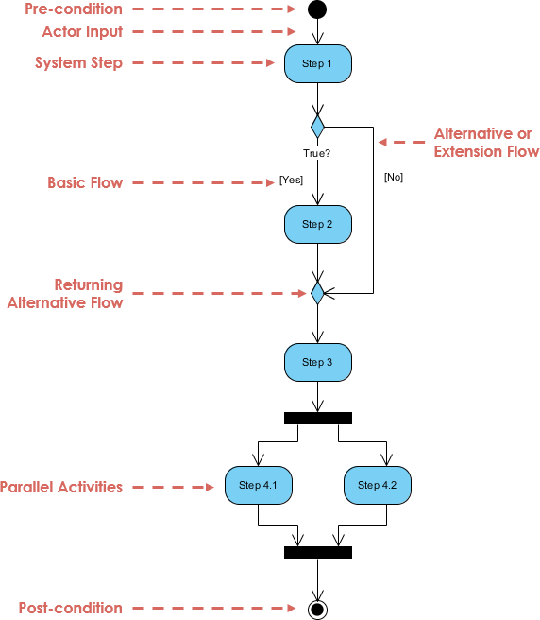
Activity Diagram

Slide 38
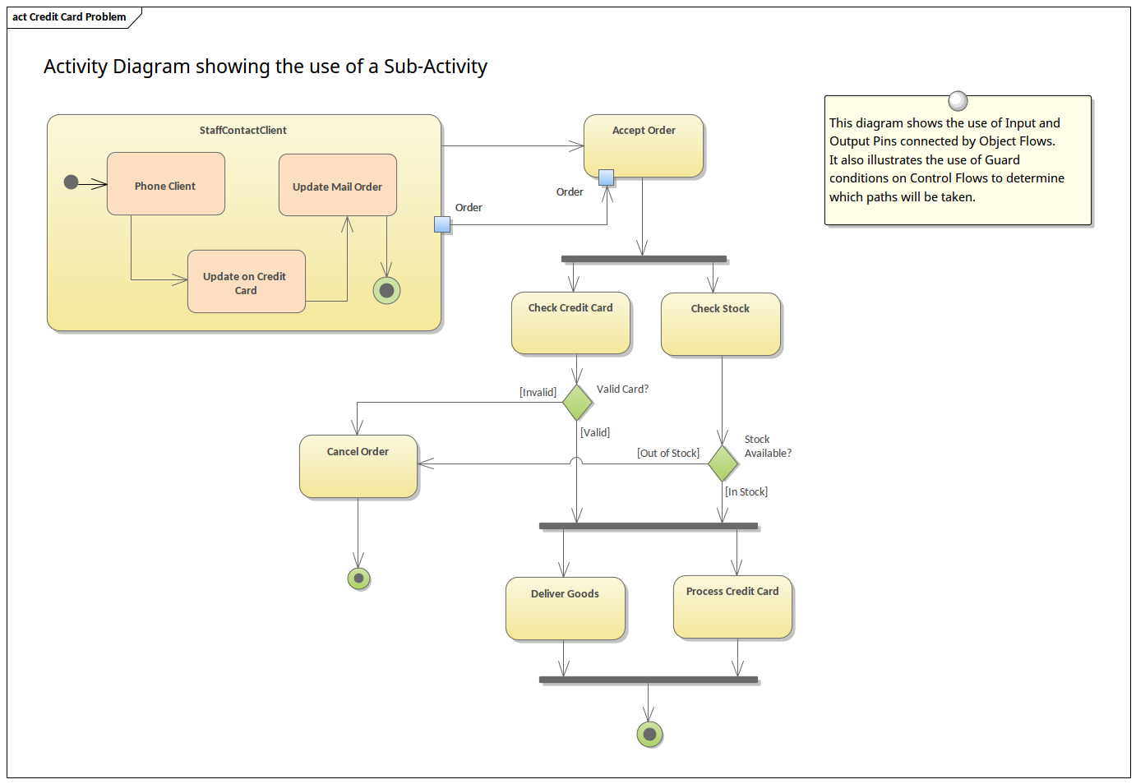
Activity Diagram

Slide 39
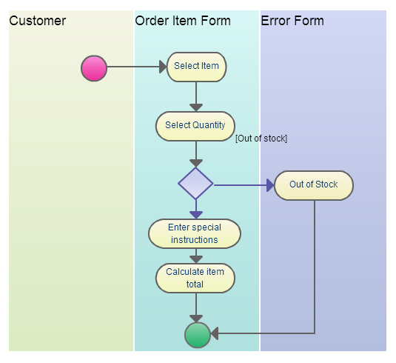
Activity Diagram

Slide 40
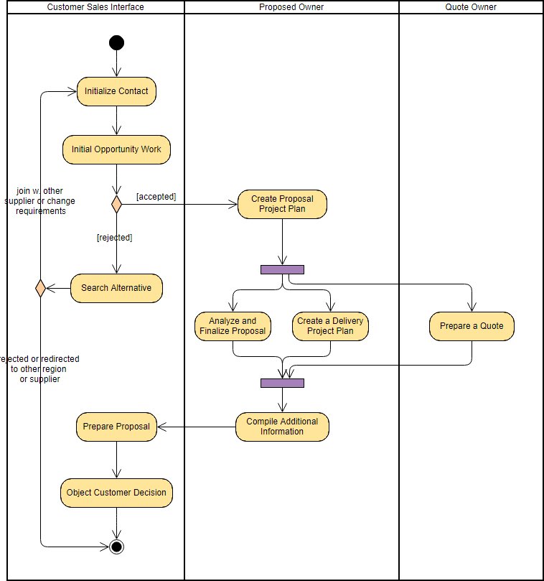
Activity Diagram

Slide 41

Component diagram
A component diagram shows the organizations and dependencies among a set of components. Component diagrams address the static implementation view of a system. They are related to class diagrams in that a component typically maps to one or more classes, interfaces, or collaborations.

Slide 42
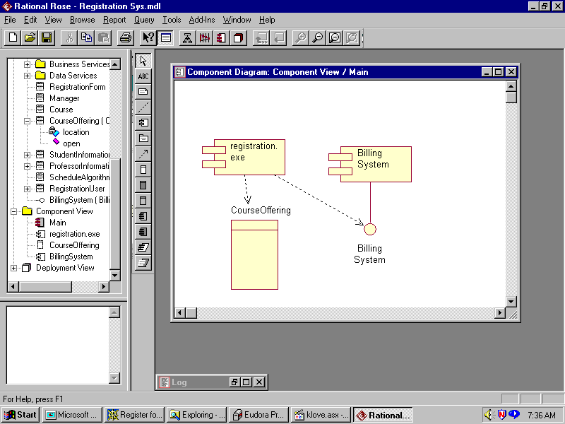
Component Diagram

Slide 43

Deployment diagram
A deployment diagram shows the configuration of run-time processing nodes and the components that live on them. Deployment diagrams address the static deployment view of an architecture. They are related to component diagrams in that a node typically encloses one or more components.

Slide 44
System Architecture 4+1 View
modeling a system’s architecture
Booch, Jacobson, Rumbaugh. The Unified Modeling Language User Guide. Addison Wesley. 1999. fig. 2-20
vocabulary
functionality
system assembly
configuration management
design
view
implementation
view
use case
view
behavior
process
view
deployment
view
performance
scalability
throughput
system topology
distribution
delivery
installation

Slide 45
System Architecture 4+1 View
4+1 is a view model designed by Philippe Kruchten for "describing the architecture of software-intensive systems, based on the use of multiple, concurrent views".
The views are used to describe the system from the viewpoint of different stakeholders, such as end-users, developers and project managers.
The four views of the model are logical, development, process and physical view. In addition selected use cases or scenarios are used to illustrate the architecture serving as the 'plus one' view. Hence the model contains 4+1 views.

Slide 46
System Architecture 4+1 View
Logical view: The logical view is concerned with the functionality that the system provides to end-users. UML diagrams used to represent the logical view include, class diagrams, and state diagrams.
Process view: The process view deals with the dynamic aspects of the system, explains the system processes and how they communicate, and focuses on the runtime behavior of the system. The process view addresses concurrency, distribution, integrators, performance, and scalability, etc. UML diagrams to represent process view include the activity diagram. It is used by Integrators, QA, etc.

Slide 47
System Architecture 4+1 View
Development view: The development view illustrates a system from a programmer's perspective and is concerned with software management. This view is also known as the implementation view. It uses the UML Component diagram to describe system components. UML Diagrams used to represent the development view include the Package diagram.
Physical view: The physical view depicts the system from a system engineer's point of view. It is concerned with the topology of software components on the physical layer as well as the physical connections between these components. This view is also known as the deployment view. UML diagrams used to represent the physical view include the deployment diagram

Slide 48
System Architecture 4+1 View
Scenarios: The description of an architecture is illustrated using a small set of use cases, or scenarios, which become a fifth view. The scenarios describe sequences of interactions between objects and between processes. They are used to identify architectural elements and to illustrate and validate the architecture design. They also serve as a starting point for tests of an architecture prototype. This view is also known as the use case view. It is used by all stakeholders.

